Slide 1
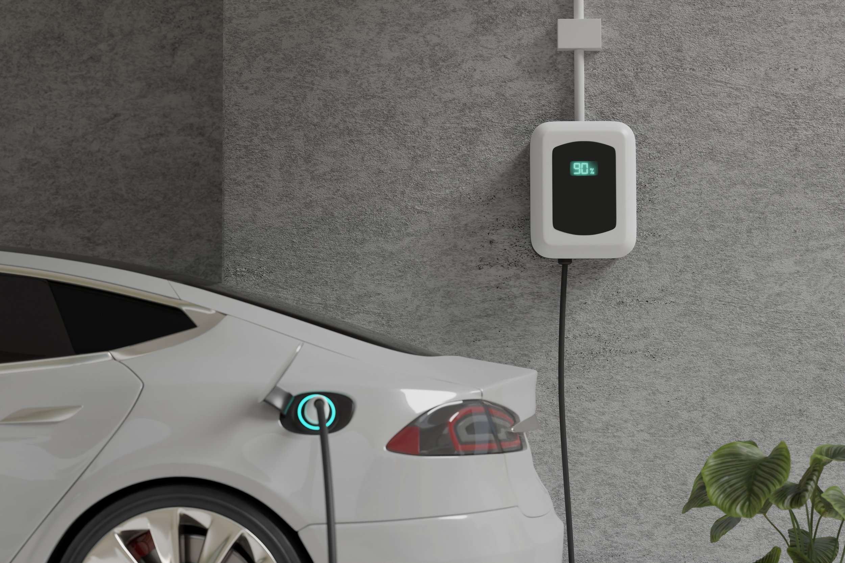
Rentchargeable
Community-Powered EV Charging
Benedikt Demahrter, Dowiw Monjardin, Konstantin Vannson, Margarita Anishchenko

Slide 2
Introduction
What?
A mobile and desktop app that instantly shows you the closest neighbors who have available EV chargers
Why?
Electric cars are growing fast, but home chargers aren’t
Not everyone has access to a private charger
Public charging often means waiting, detours, and unpredictable availability.
Many households with chargers use them only a few hours a day

Slide 3
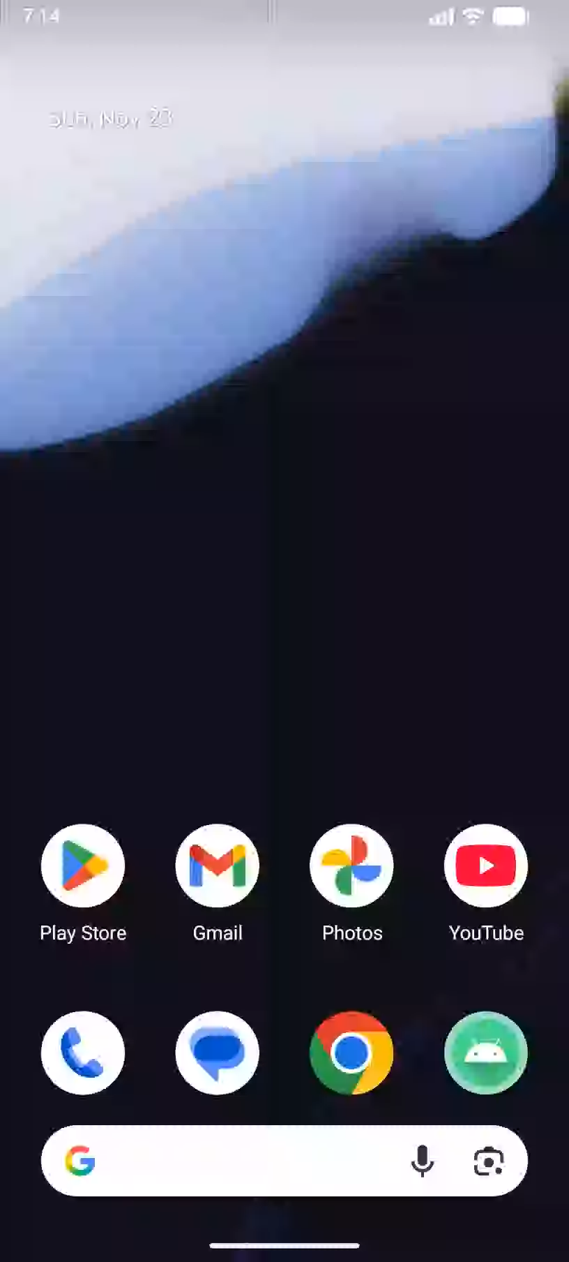
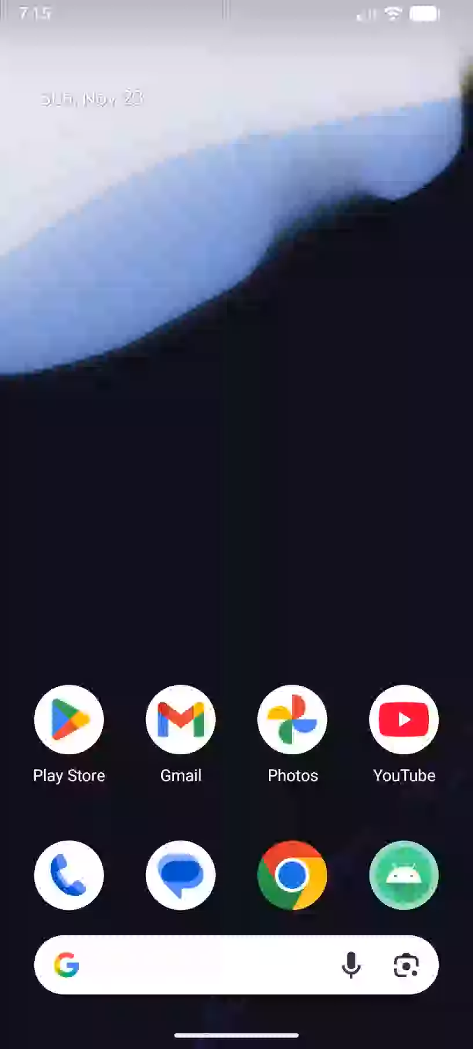
Live Demo

Slide 4
Tech Stack & Architecture
Kotlin
IntelliJ
Android Studio

Slide 5
The Difference We Make
Accelerates EV Adoption
Reduces Pressure on Public Infrastructure
Empowers People Without Home Chargers
Promotes Sustainable Communities
Strengthens Local Connections

Slide 6

Thank you for your attention

